Slide 1

Original Article A Phase 3, Randomized, Controlled Trial of Resmetirom in NASH with Liver Fibrosis
Stephen A. Harrison, M.D., Pierre Bedossa, M.D., Ph.D., Cynthia D. Guy, M.D., Jörn M. Schattenberg, M.D., Rohit Loomba, M.D., M.H.Sc., Rebecca Taub, M.D., Dominic Labriola, Ph.D., Sam E. Moussa, M.D., Guy W. Neff, M.D., Mary E. Rinella, M.D., Quentin M. Anstee, M.D., Ph.D., Manal F. Abdelmalek, M.D., M.P.H., Zobair Younossi, M.D., Seth J. Baum, M.D., Sven Francque, M.D., Michael R. Charlton, M.D., Philip N. Newsome, M.D., Nicolas Lanthier, M.D., Ph.D., Ingolf Schiefke, M.D., Alessandra Mangia, M.D., Juan M. Pericàs, M.D., Ph.D., Rashmee Patil, M.D., Arun J. Sanyal, M.D., Mazen Noureddin, M.D., M.H.Sc., Meena B. Bansal, M.D., Naim Alkhouri, M.D., Laurent Castera, M.D., Ph.D., Madhavi Rudraraju, M.D., Vlad Ratziu, M.D., Ph.D., for the MAESTRO-NASH Investigators
N Engl J Med
Volume 390(6):497-509
February 8, 2024

Slide 2
Study Overview
Resmetirom is a selective agonist of THR-β.
In adults with nonalcoholic steatohepatitis and fibrosis, daily resmetirom (80 mg or 100 mg) was superior to placebo with respect to NASH resolution and fibrosis improvement.

Slide 3
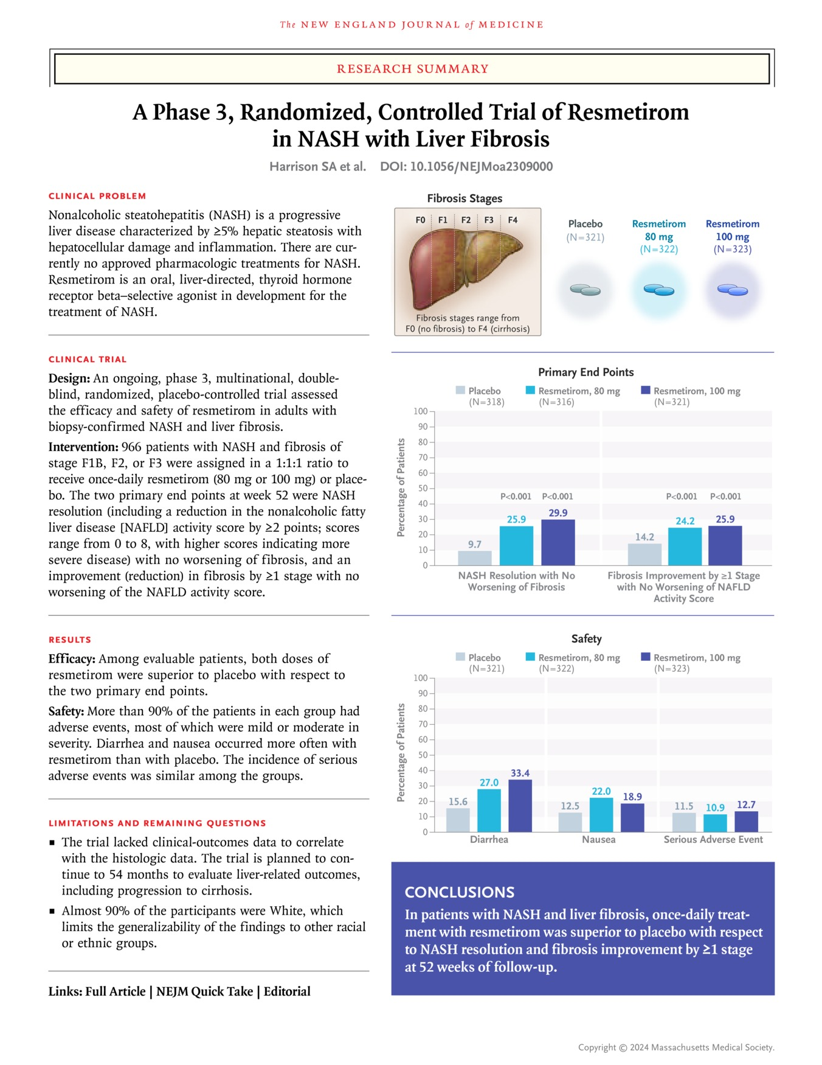
Harrison SA et al. N Engl J Med2024;390:497-509
Notes:
Download a PDF of the Research Summary.

Slide 4
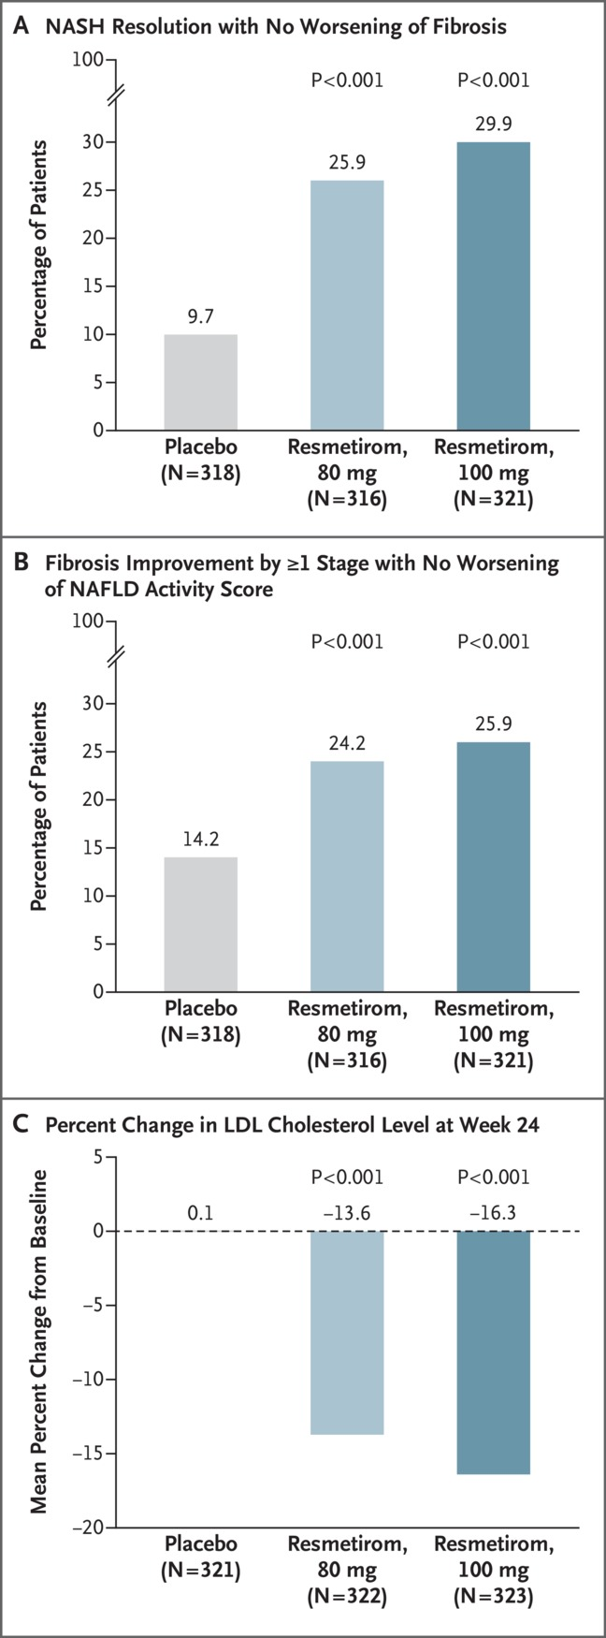
Primary and Key Secondary End Points.
Harrison SA et al. N Engl J Med2024;390:497-509
Notes:
Figure 1 Primary and Key Secondary End Points. The two primary end points at week 52 were resolution of nonalcoholic steatohepatitis (NASH) with no worsening of fibrosis (Panel A), and an improvement (reduction) in fibrosis by at least one stage with no worsening of the nonalcoholic fatty liver disease (NAFLD) activity score (Panel B). The key secondary end point was the percent change from baseline in the low-density lipoprotein (LDL) cholesterol level at week 24 (Panel C). The NAFLD activity score is assessed on a scale of 0 to 8, with higher scores indicating more severe disease; the components of this measure are steatosis (assessed on a scale of 0 to 3), lobular inflammation (assessed on a scale of 0 to 3), and hepatocellular ballooning (assessed on a scale of 0 to 2). NASH resolution was defined as achievement of a hepatocellular ballooning score of 0, a lobular inflammation score of 0 or 1, and a reduction in the NAFLD activity score by at least 2 points. Fibrosis stages range from F0 (no fibrosis) to F4 (cirrhosis). A total of 11 patients had a delay in their week 52 biopsy due to coronavirus disease 2019–related closure of the biopsy site or related reasons and were removed from the primary analysis population for liver-biopsy analyses.

Slide 5
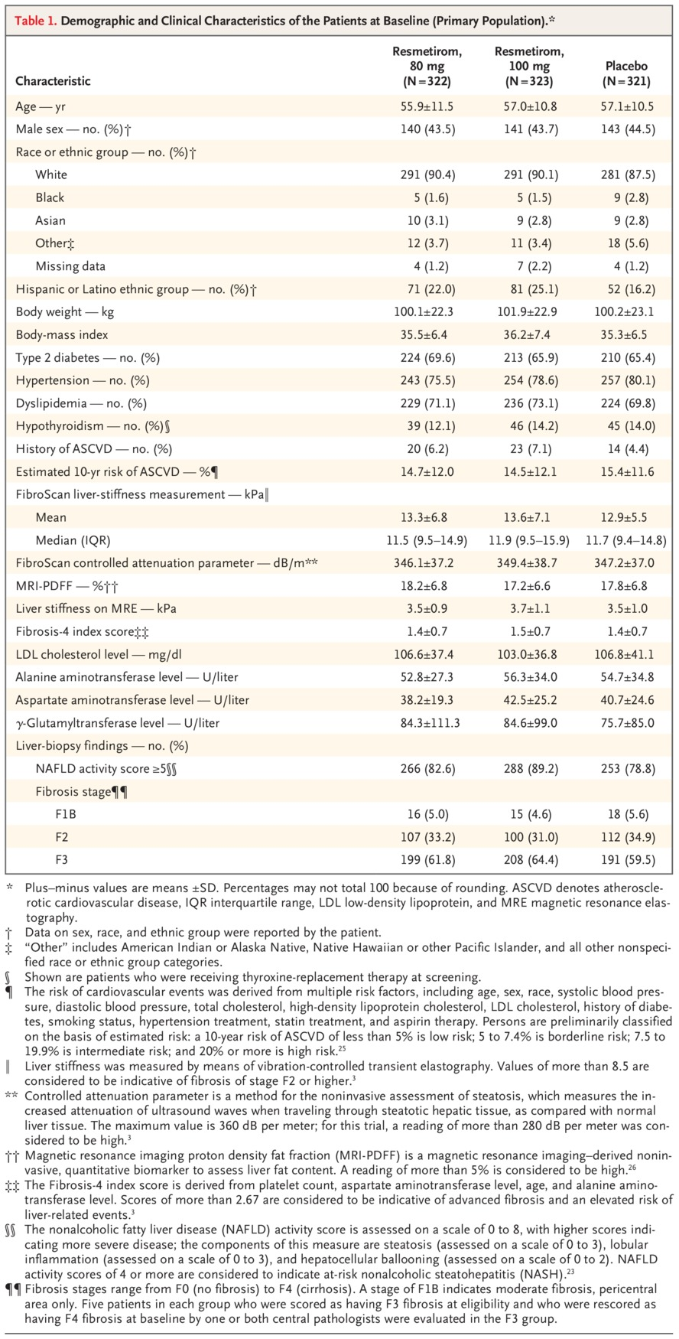
Demographic and Clinical Characteristics of the Patients at Baseline (Primary Population).
Harrison SA et al. N Engl J Med2024;390:497-509
Notes:
Table 1 Demographic and Clinical Characteristics of the Patients at Baseline (Primary Population).

Slide 6
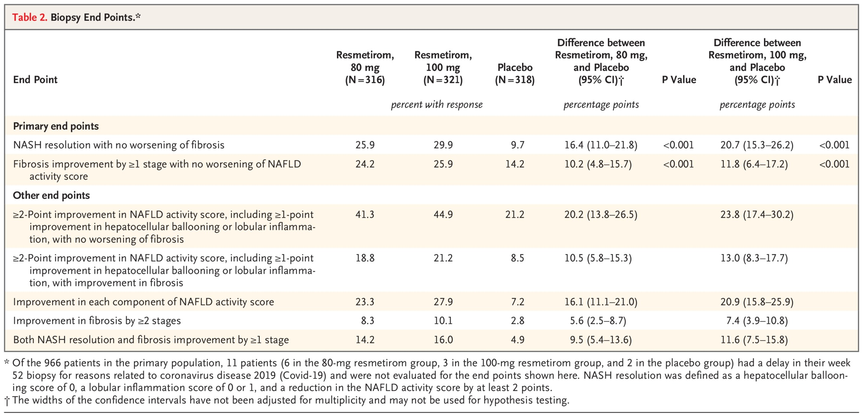
Biopsy End Points.
Harrison SA et al. N Engl J Med2024;390:497-509
Notes:
Table 2 Biopsy End Points.

Slide 7
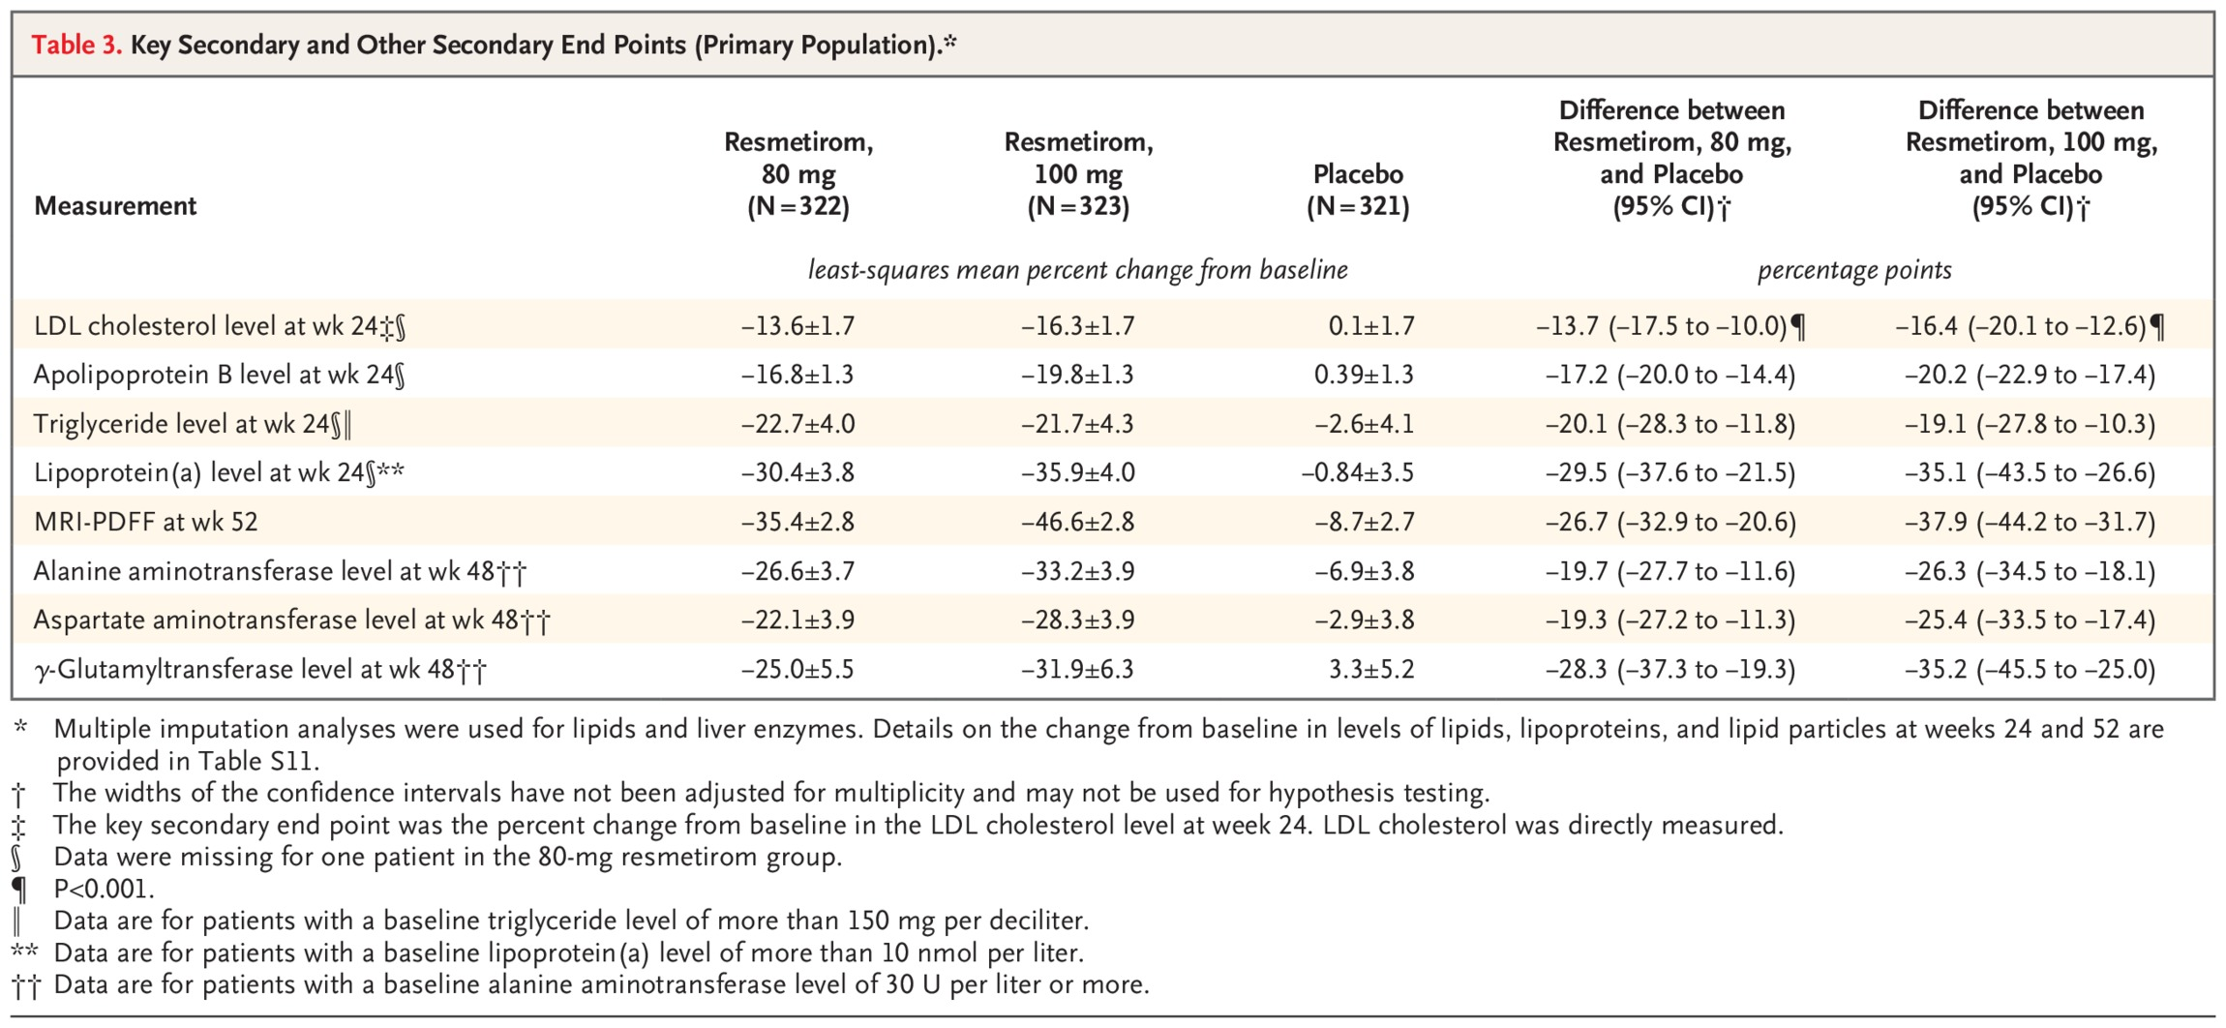
Key Secondary and Other Secondary End Points (Primary Population).
Harrison SA et al. N Engl J Med2024;390:497-509
Notes:
Table 3 Key Secondary and Other Secondary End Points (Primary Population).

Slide 8
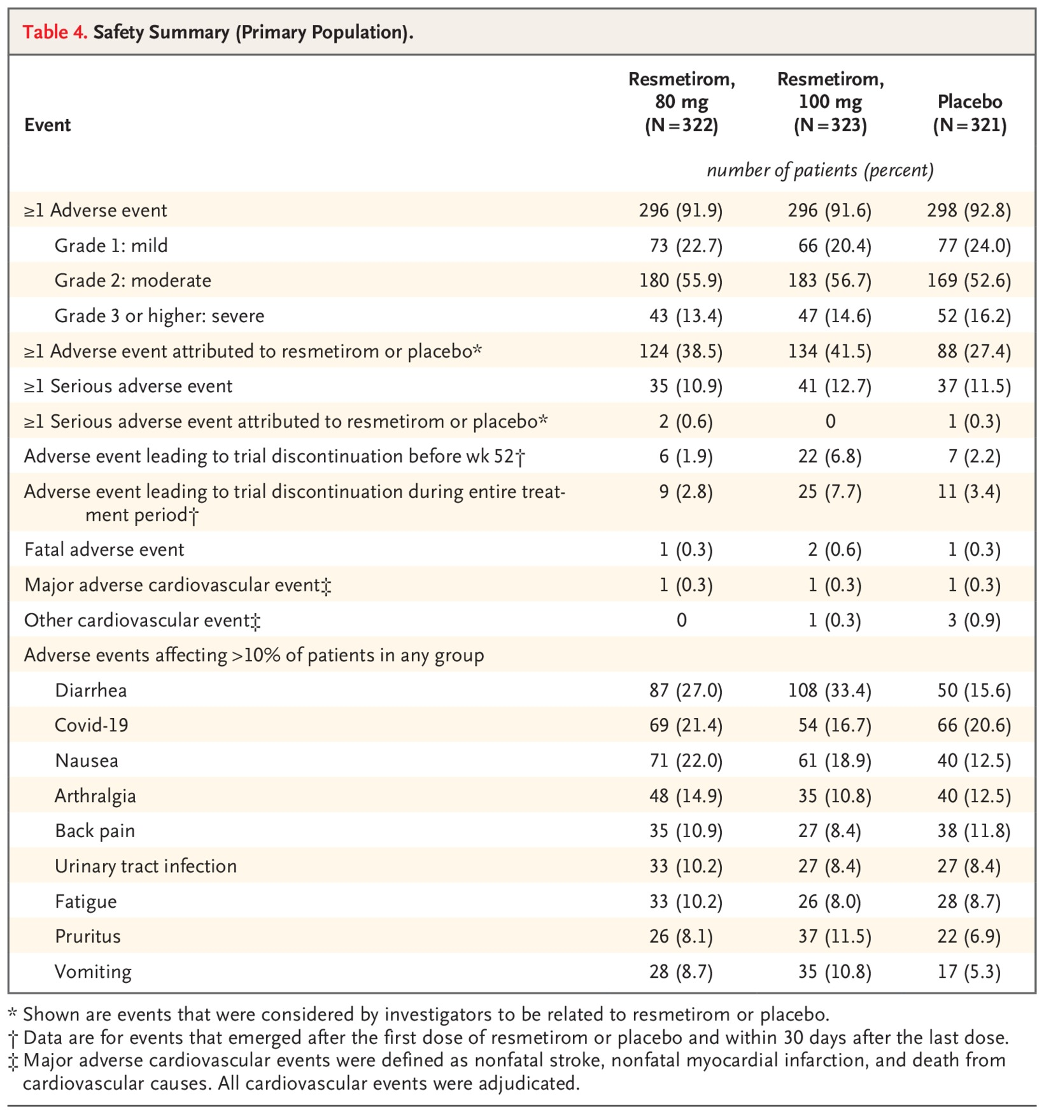
Safety Summary (Primary Population).
Harrison SA et al. N Engl J Med2024;390:497-509
Notes:
Table 4 Safety Summary (Primary Population).

Slide 9
Conclusions
Both the 80-mg dose and the 100-mg dose of resmetirom were superior to placebo with respect to NASH resolution and improvement in liver fibrosis by at least one stage.

